Slide 1









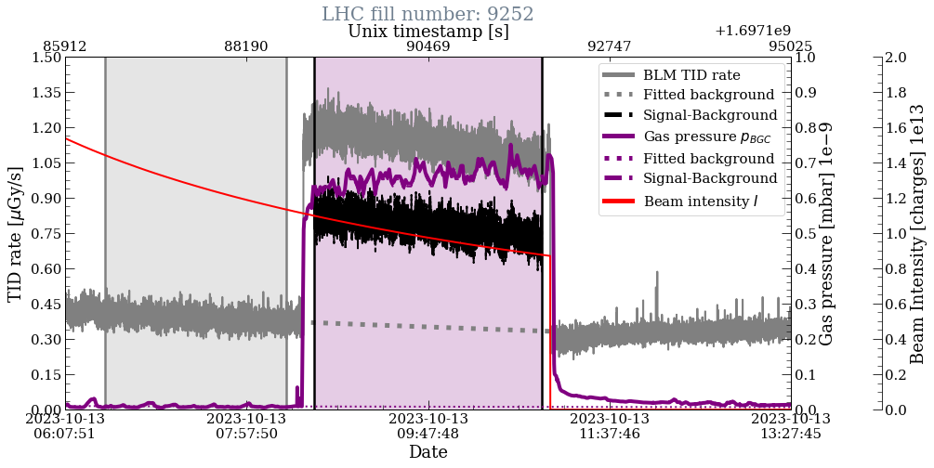
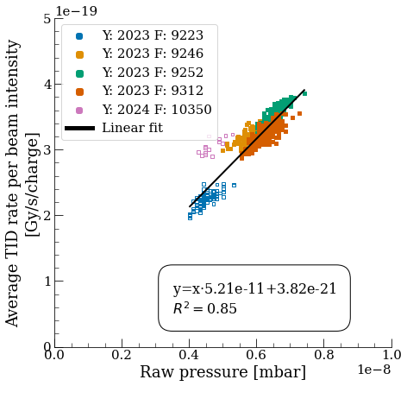
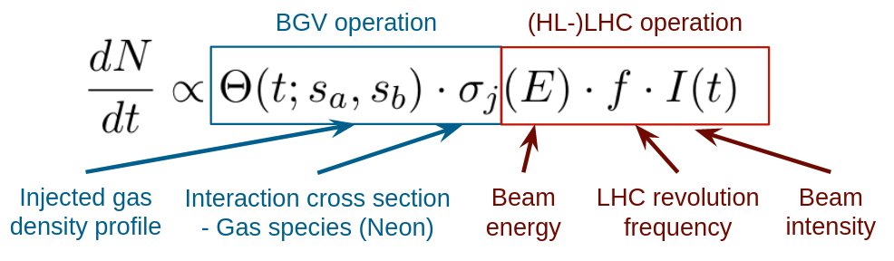
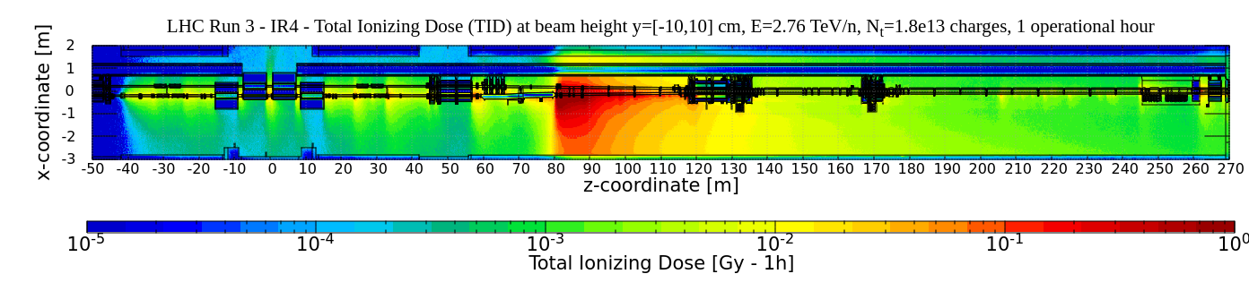
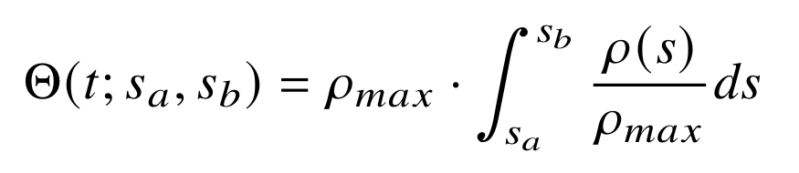
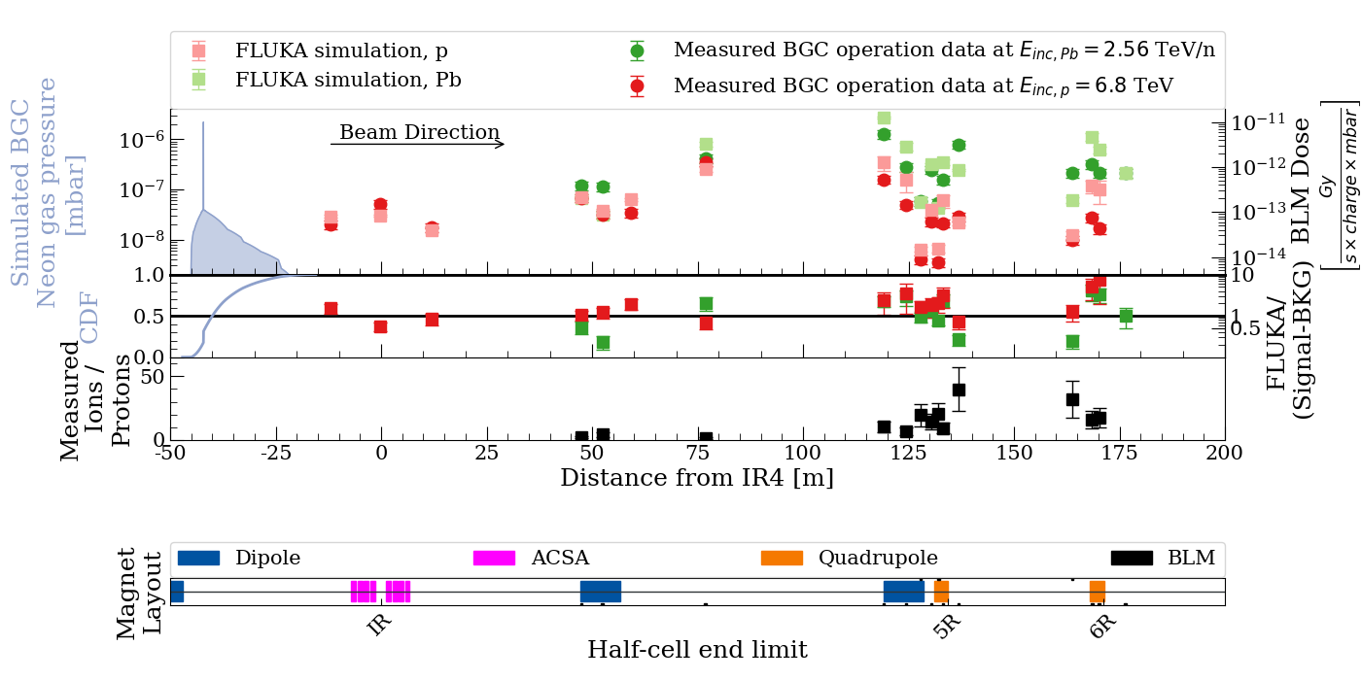
RADIATION LEVELS FROM A BEAM GAS CURTAIN INSTRUMENT AT
THE LHC AT CERN DURING ION OPERATION
Daniel Prelipcean (daniel.prelipcean@cern.ch), Giuseppe Lerner, Rubén García Alía, Gerhard Schneider, Daniele Butti, Ondrej Sedlacek, Raymond Veness, Cristina Castro Sequeiro, Marton Ady
CERN (CH-1211 Geneva)
1. The Large Hadron Collider
3. Measured BLM data from the LHC Run 2
The radiation levels caused by the Beam Gas Curtain (BGC) [1] operation in Interaction Region 4 (IR4) of the Large Hadron Collider (LHC) [2] at CERN are discussed, during ion operation. The key ingredients of the analysis are:
Measurements of Total Ionising Dose (TID) performed with the Beam Loss Monitoring (BLM) system [3] from LHC Run 3 (2022-to date), during the ion operation of the BGC demonstrator.
Simulations performed with the FLUKA.CERN [4-6] code of beam gas interactions for the past LHC Run 2 (benchmark) and future HL-LHC scenarios (prediction).
The main goal is to determine whether the operation of these devices can lead to Radiation to Electronics (R2E) [7-8] issues, or excessive magnet heat loads. A similar study has been performed for the proton operation of the BGC during Run 3 [9], as well as for the the Beam Gas Vertex (BGV) monitor during Run 2 [10].
During a fill, when gas is injected in the BGC, one expects the BLM TID rate signal to be proportional to the product of pressure and intensity. For the analysis, we have looked at instantaneous (~1 s time resolution) correlations between the measured variables (Fig. 1).
2. Radiation source and normalization
Any residual gas will lead to beam-gas interactions causing local radiation showers. This effect can be used to measure the beam profile/position, if there are sufficient secondaries produced. The Beam Gas elements in IR4 inject gas (typically Ne) to increase the local density and measure the secondaries for beam profile reconstruction. The radiation levels scale as:
Fig. 1: (Left) The measured TID rate for the most irradiated BLM (z=80 m) downstream of the BGC within a time period of LHC fill number 9252, showing the beam intensity 𝑁_{𝑝} as measured by the BCT instruments for beam 1 and the one of the BGC pressure gauges reading 𝑝_{𝐵𝐺C}. (Right) The measured TID of the BLM divided by the number of charges passing through the BGC, 𝑁_{𝑝}, plotted against the average BGC pressure gauge reading 𝑝_{𝐵𝐺C} for all the timestamps.
4. FLUKA simulation
The radiation source consisted in just the electromagnetic dissociation and inelastic beam-gas interactions, as the position of the interactions is sampled along a Continuous Distribution Function (CDF) function given by the gas density profile in the tunnel, and the interaction secondaries are propagated in the LHC tunnel geometry model.
with the number of charges I(𝑡) passing through the gas, the LHC revolution frequency 𝑓 = 11 245 Hz, the interaction cross section for the ion beam and the rest gas is estimated at 𝜎_{Pb+𝑁𝑒,𝑖𝑛𝑒𝑙} = 𝜎_{pp,𝑖𝑛𝑒𝑙} · (A^{1/3}_{Pb} + A^{1/3}_{Ne})² = 3800 mb, for a beam of Pb at 2.76 TeV/n hitting the gas atoms. Moreover, if for the proton case [9] the only relevant physical process leading to local radiation levels was the inelastic interaction, for the case of ions there is an additional electromagnetic dissociation component. The gas with an integrated density profile Θ(𝑡; 𝑠_{𝑎}, 𝑠_{𝑏}) along 𝑠-coordinate in the accelerator region [𝑠_{𝑎}, 𝑠_{𝑏}] can be expressed as
Fig. 2: FLUKA simulated radiation shower caused by the BGC demonstrator (z=-42 m) on beam 1 for LHC ion operation, as ZX view, displaying how the shower extends over several tens of meters. The TID is provided at beam height, for a beam at 𝐸 = 2.76 TeV/n with an intensity of 𝑁_{𝑡} = 8 · 10¹³ charges, and normalized to 1 operational hour.
5. FLUKA vs Measured data and HL-LHC levels
where 𝜌(𝑠) is the number density of gas atoms and 𝜌_{𝑚𝑎𝑥} is the peak value of the profile. The gas density profile used in FLUKA (the top panel of Fig. 3) has been simulated using MOLFLOW+ [11] more description about how these profiles are obtained can be found in Ref. [12].
The radiation levels simulated by FLUKA are compared to the BLM measurements (background-subtracted) taken during the operation of the BGC demonstrator in Run 3
(2022-to date) in Fig. 3. The shape of the BLM TID profile is well reproduced with a good global agreement within at least a factor of 2 between simulations and measurements, with some outliers at large distance from the radiation source. The lower pad of Fig. 4 indicates that the ratio of normalized ion radiation levels to proton radiation levels can reach locally a factor of a few tens.
6. Conclusions
The main results of this study are the observed proportionality between the TID measured by the BLMs and the product of gas pressure and beam intensity more than 200 m downstream of the BGC, signaling that in this region of tunnel the BGC was indeed a measurable (and often dominant) radiation source, also for the ion operation. The comparison between the Run 3 measurements and the FLUKA simulation reveals a good agreement, which is a further confirmation that we understand the origin of the radiation levels.
The BLM levels reveal a different pattern compared to the proton operation, with a larger fraction of the radiation further away from the BGC instrument. However, when taking into consideration the beam intensity, the absolute radiation level rates are comparable. Cumulatively, as ion operation typically lasts for about 1 month, compared to the high intensity proton operation for about 6 months, the integrated radiation levels at IR4 are dominated by the proton run, and not by the ion run.
From a machine protection point of view, the simulated radiation levels are not an issue for what concerns the heat loads on the magnets, both as maximum power density or as total power dissipated on the entire magnet. Similarly, the TID levels do not raise any concerns in terms of cumulated damage to the magnets. However, the levels can have significant impact on electronics in the tunnel and nearby alcoves, both in terms of lifetime degradation and Single Event Effect (SEE) risk.
Fig. 3: Top panel: The BGC gas density profile used to generate the radiation shower, together with the BLM data downstream the BGC placed on beam 1 as measured over the LHC Run 3 proton operation (red points) [9] and ion operation (green points), as well as those simulated by FLUKA. Mid panel: The CDF computed from the gas profile, together with the ratio between the simulated values over measured data for Run 3, for both protons (red) and ions (green). Bottom panel: The ratio of measured radiation levels rates (normalized to unit charge and pressure) of the ion over proton operation. Bottom pad: The machine layout and the BLM locations for the LHC machine.
References
The BGC Collaboration, Characterization of a supersonic molecular beam for charged particle beam profile monitor. Vacuum, Volume 208, 2023, 111701, https://doi.org/10.1016/j.vacuum.2022.111701.
O. Brüning et al. LHC Design Report. CERN Yellow Reports: Monographs. CERN, Geneva, 2004. doi:10.5170/CERN-2004-003-V-1. URL https://cds.cern.ch/record/782076.
E. B. Holzer et al. Beam loss monitoring system for the LHC. IEEE Nuclear Science Symposium, 2:1052 –1056, November 2005. doi: 10.1109/NSSMIC.2005.1596433.
FLUKA website. URL https://fluka.cern.
FLUKA.CERN Collaboration. New Capabilities of the FLUKA Multi-Purpose Code. Frontiers in Physics, 9, 2022. ISSN 2296-424X. URL https://www.frontiersin.org/article/10.3389/fphy.2021.788253.
FLUKA.CERN Collaboration. Overview of the FLUKA code. Annals Nucl. Energy, 82:10–18, 2015. DOI: 10.1016/j.anucene.2014.11.007.
The Radiation to Electronics (R2E) activity at CERN, website. URL https://r2e.web.cern.ch/.
M. Brugger. R2E and availability. In Proc. of Workshop on LHC Performance, Chamonix, France, 2014.
D. Prelipcean et al., “Radiation levels from a Beam Gas Curtain instrument at the LHC at CERN”, in IPAC 2024, DOI: 10.18429/JACoW-IPAC2024-THPG58.
D. Prelipcean et al. Radiation levels produced by the operation of the Beam Gas Vertex monitor in the LHC tunnel at IR4, in IPAC 2023, DOI: 10.18429/JACoW-IPAC2023-THPL083.R. Kersevan and M. Ady. Recent Developments of Monte-Carlo Codes Molflow+ and Synrad+, in IPAC2019, DOI: 10.18429/JACoW-IPAC2019-TUPMP037.
R. Kersevan and M. Ady, “Recent Developments of Monte Carlo Codes Molflow+ and Synrad+”, 2019, pp. 1327–1330.
C. Castro Sequeiro et al., “Beam gas curtain monitor: Vacuum studies for lhc integration and operation”, Phys. Rev. Accel. Beams, vol. 27, p. 043 201, 4 2024. doi:10.1103/PhysRevAccelBeams.27.043201

